Slide 1
Spring Boot

Slide 2
What is spring boot?
Spring Boot makes it easy to create stand-alone, production-grade Spring based Applications that you can "just run".

Slide 3
Features
Create stand-alone Spring applications
Embed Tomcat, Jetty or Undertow directly (no need to deploy WAR files)
Provide opinionated 'starter' POMs to simplify your Maven configuration
Automatically configure Spring whenever possible
Provide production-ready features such as metrics, health checks and externalized configuration
Absolutely no code generation and no requirement for XML configuration

Slide 4
How do we run It?
The recommended way to get started using spring-boot in your project is with a dependency management system.

Slide 5
Practice
First we run a clean install to get all the dependencies.

Slide 6
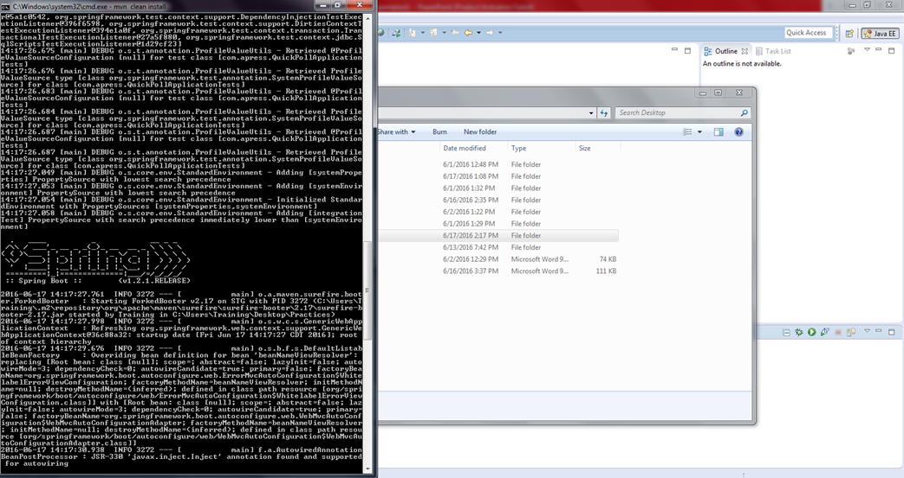

Slide 7
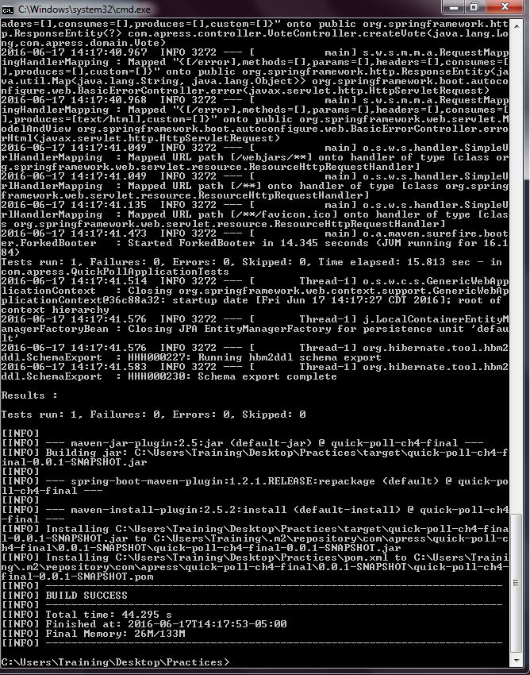
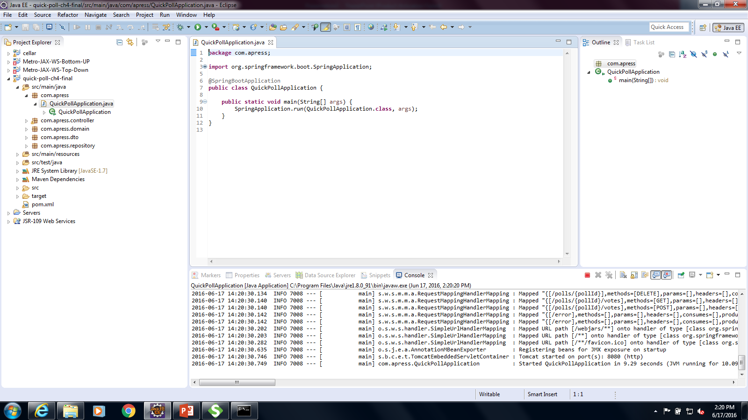

Slide 8
Once its done we can run the application.

Slide 9
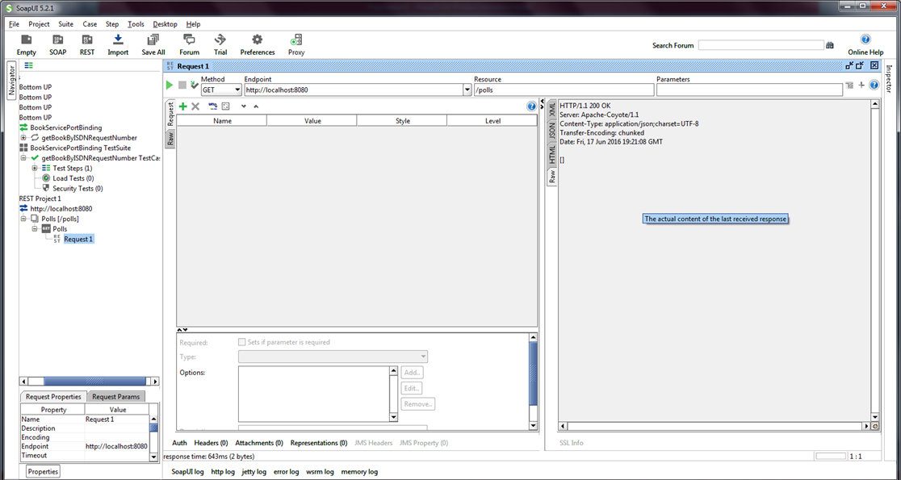

Slide 10
Conclusion
Spring Boot helps us to create stand-alone, production-grade Applications, no need to deploy WAR files, for a fast solution.

